Slide 1
Expense Management System
Product Road Map
MAY
MARCH
APRIL
Asset management & Travel
Phát Triển
Medium Priority – Due Date: 31 May
Enhancement Purchase Requisition﻿
Purchase Order﻿
Cải thiện
Medium Priority – Due Date: 31 May
Thêm các chức năng
Medium Priority – Due Date: 31 May

Slide 2
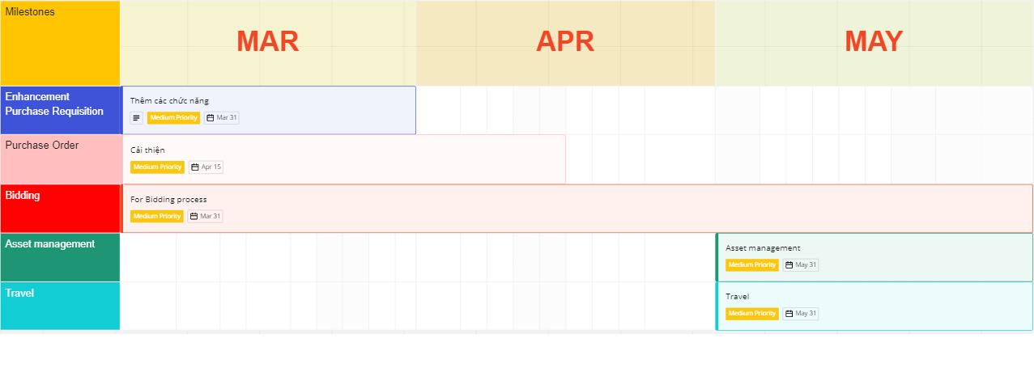

Slide 3
